Slide 1
The p-Value

Slide 2
The p-Value
When reporting the outcome of statistical hypothesis tests, it has become standard practice to report the p-value (an abbreviation for probability value) of the test.
The p-value of the test tell us what is probability of committing a Type I error according to our t-statistic and the alternative hypothesis.

Slide 3
The p-Value
If t is the calculated value of the t-statistic, then:
if H₁: β_{K} > c
p = probability to the right of t
if H₁: β_{K} < c
p = probability to the left of t
if H₁: β_{K} ≠ c
p = sum of probabilities to the right of |t| and to the left of – |t|

Slide 4
The p-Value
p-VALUE RULE
Reject the null hypothesis when the p-value is less than, or equal to, the level of significance α:
If p ≤ α then reject H₀.
If p > α then do not reject H₀.

Slide 5
The p-Value
p-Value for a Left-tail Test
Example 1
The null hypothesis is H₀: β₂ ≥ 15
The alternative hypothesis is H₁: β₂ < 15
The p-value is (left tail test)
We reject the null hypothesis for α = 0.05 but not for α = 0.01.

Slide 6
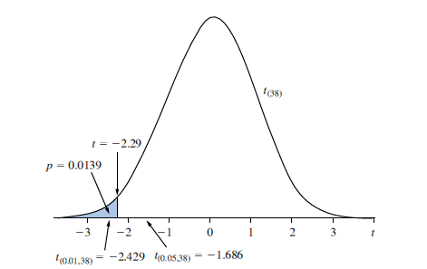
The p-Value
The p-value for a left-tail test.
p-Value for a Left-tail Test

Slide 7
The p– value
P- value for a Right tail Test
Example 2
The null hypothesis is H₀:β₂ = 0
The alternative hypothesis is H₁:β₂ > 0
The test statistic:
The p-value (right tail):
We reject the null hypothesis for both α = 0.05 and for α = 0.01.

Slide 8
The p-Value
p-Value for a Two-tail Test of Significance
Example 3
The null hypothesis is H₀: β₂ = 0
The alternative hypothesis is H₁: β₂ ≠ 0
The p-value is (a two tail test!)

Slide 9
The p-Value
p-Value for a Two-tail Test of Significance
Every regression output provides the calculated p-value for the two tail test of significance.

